Slide 1
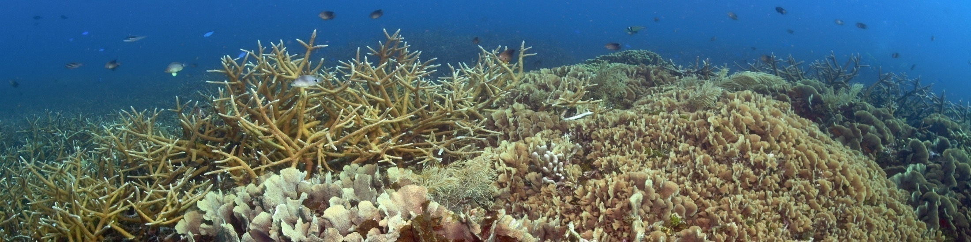

Kip Evans/Mission Blue
Evaluating Reef Health and Management Response
in the Mesoamerican Reef
ICRS, JULY 2012
Lorenzo Alvarez Filip, Ian Drysdale, Marisol Rueda,
Roberto Pott, Ana Giro
Melanie McField, PhD
Director, Healthy Reefs Initiative
Smithsonian Institution
Notes:
Healthy Reefs for Healthy People - a collaborative international initiative that translates scientific monitroing into reports tand rec’s to improve decision-making that effectively sustains social and ecosystem well-being.

Slide 2
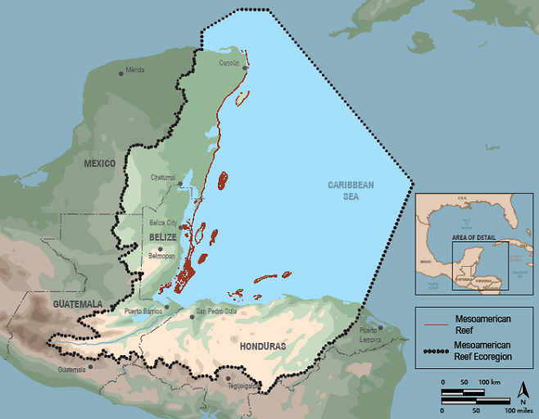
We Want and Need to Manage it All
Notes:
The MAR is Large area 100okm 4 countries many socio-political- environmental issues. HRI evaluates both the health of this ecosystem and and progress in improving managemnet actions.

Slide 3
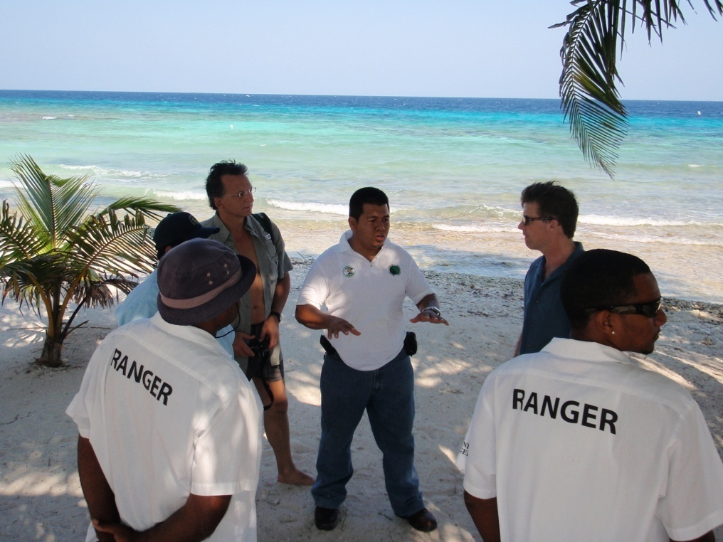
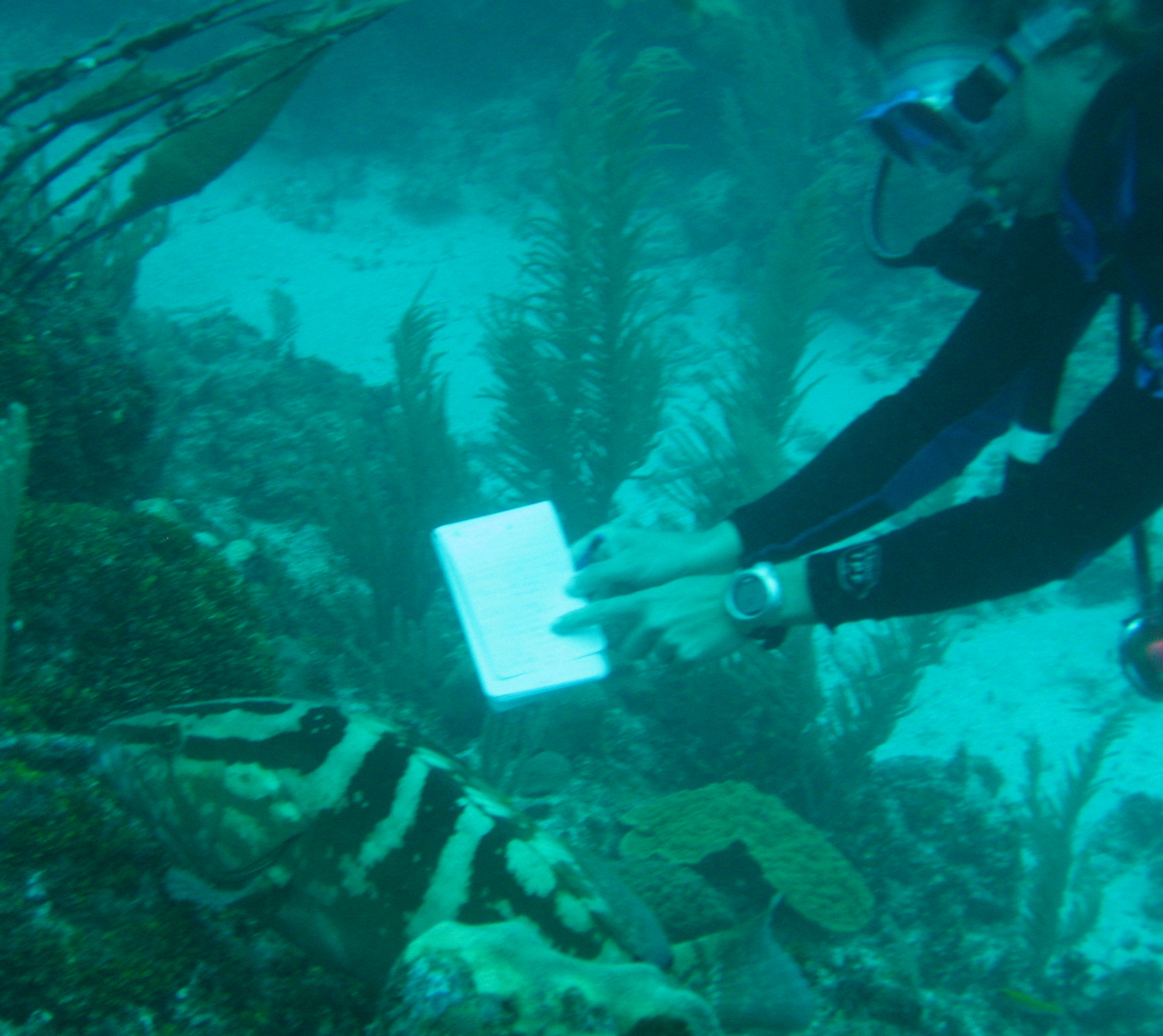
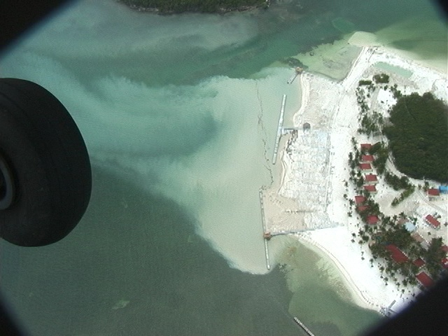
Need to Scale-up our Questions & Evaluations
Are we doing all that we can to help the reef?
protected areas
protected areas
Are management efforts having an impact on reef health?
Notes:
We are bringing together all the players in the region to answer these two fundamental questions:
Now getting answers at this larger scale adds complexity and costs….

Slide 4
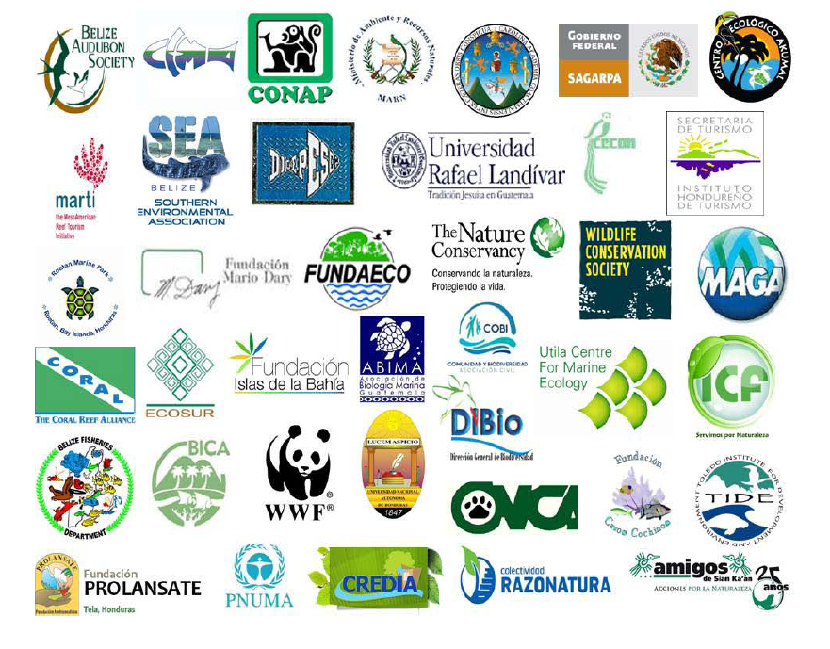
Scaling Up Through Collaboration
Notes:
One good way to scale up is to collaborate. And over 40 organization are involved…all the main NGO research and govt institutions… getting agreement is challenging….

Slide 5
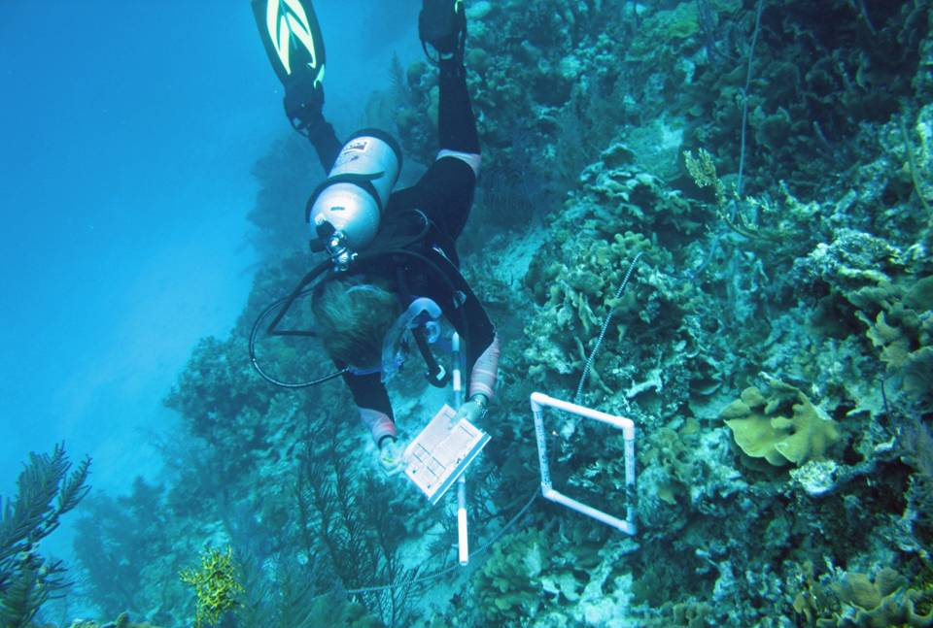
Standardized data collection and analysis
Unconventional reporting and accounting
Notes:
The work starts out basic enough.. Wih standardized monitoring protocols using mosly AGRRA or MBRS methdologies (both of twhich provide the same needed core indicators)

Slide 6
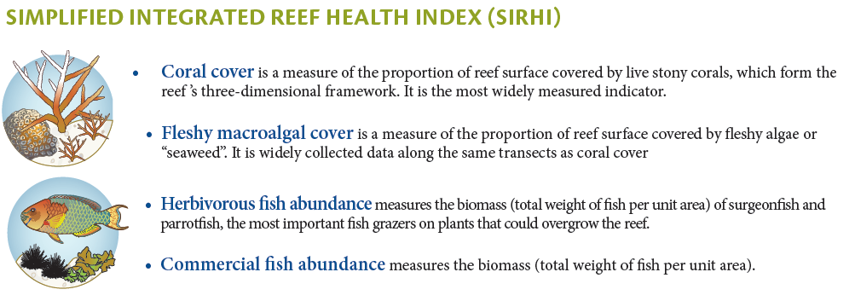
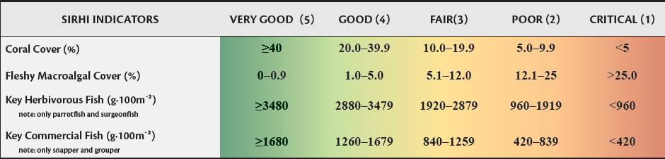
Accepted Indicators of health and threshold values for Grades
Notes:
HRI has gotten agreement on the indicators of reef health, standardization in monitoring approach, we are sharing data, and agree to ranking criteria for each.
These reef health indicators are combined in a simple index of reEf health.

Slide 7
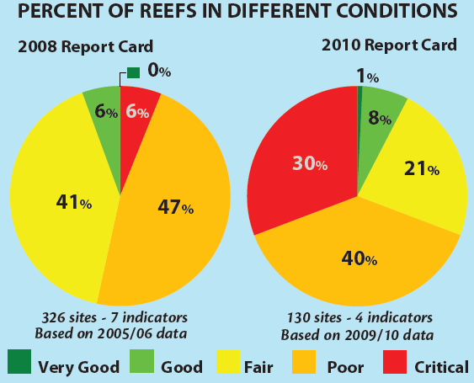
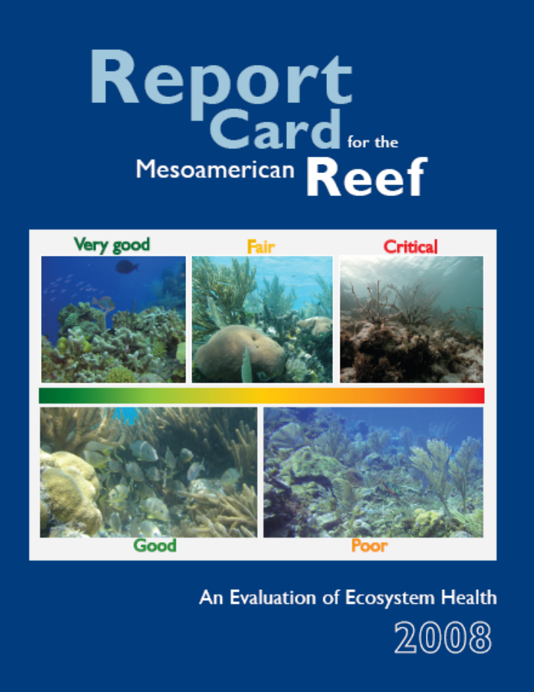
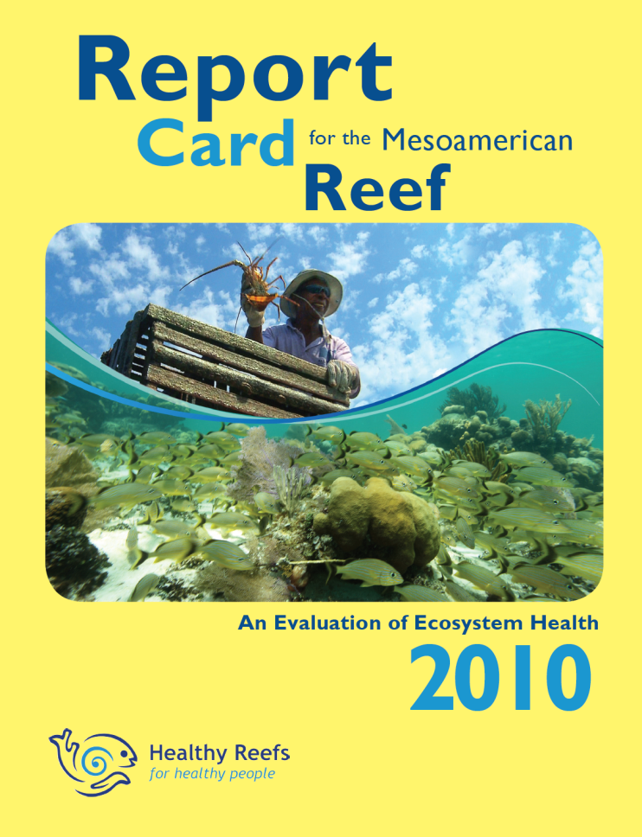
Despite increasing management efforts the reef declines continue.
Notes:
This info is the basis of biennial Report cards, written for the public and decision-makers and launched win big media events. the Report Cards trackr the big picture question about the reef’s condition.
…People and politicians now know the reef is is trouble and gettng worse… and are asking what can we do to improve it?

Slide 8
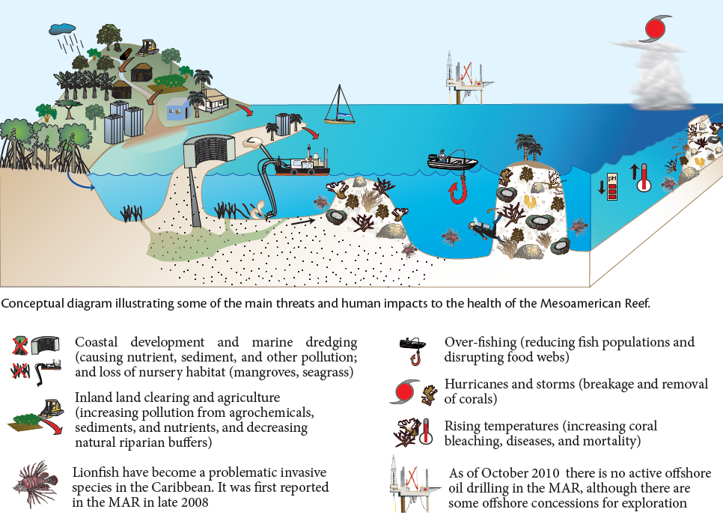
Main Threats to Reef Health
Notes:
But the reef is threatened by local and global threats and the health of the MAR is declining.

Slide 9
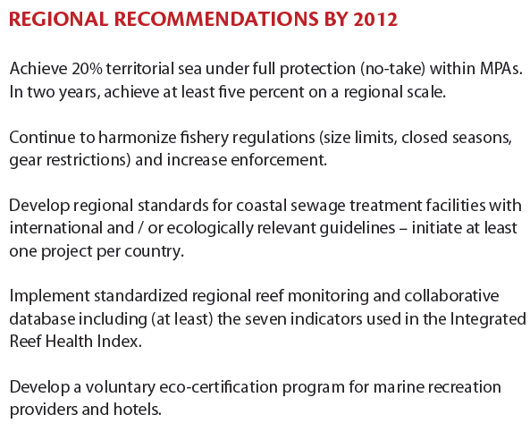
2010 Report Card Recommendations
Notes:
The Report Cards also give recommended management
But we al know there are lots of reports talk about ecosystem decline and make recommendations - with noone whose counting… or tracking IMPLEMENTATION
??? Now we are…

Slide 10
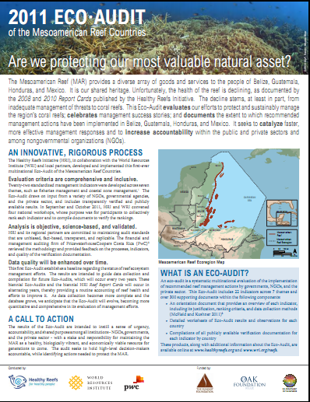
The 2011 Eco-Audit
Measuring Management Progress at a National Scale
Indicators taken directly from Report Card recommendations
Developed specific and verifiable criteria (reviewed by Price WaterhouseCoopers)
All Countries held to the same bar
All docs on www.healthyreefs.org
Notes:
HRI launched the first regional eco-audit to track this implementation.
The detailed indicators document with all of the indcators, ranking criteria, etc

Slide 11
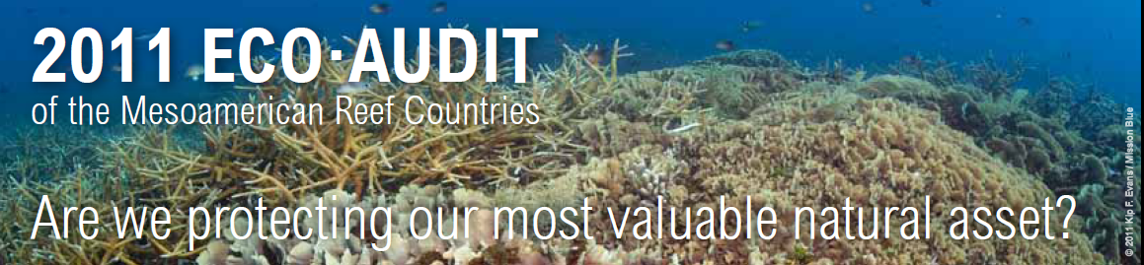
Unprecedented in scale and scope
Four countries
Over 40 organizations
Over 100 individuals
Over 300 supporting documents collected
Evaluated 22 indicators over 7 themes
Serves as basis for measuring future progress
Notes:
Conducting an Eco-Audit on this scale and with this scope is unprecedented – anywhere - as far as we can tell. Eco-audits are normally conducted at the scale of one business, organization or even a community. We have completed a multinational effort involving 4 countries, over 40 organizations, 100 individuals and providing over 300 documents for verification of the results.

Slide 12
2011 Eco-Audit – Example Indicator
5b. Economic valuation of coral reefs
Justification: Economic valuation is a tool that can aid decision making by quantifying ecosystem services provided by coral reefs in monetary terms. Valuation also provides a tool for evaluating the costs and benefits of management and economic development options, with an emphasis on long-term benefits, which can help avoid short-sighted development.
Ranking Criteria
5 – A national valuation of coral reefs or valuation of selected ecosystem services associated with 50 percent of MPAs has been completed.
4 – A valuation of two or more MPAs has been completed.
3 – A valuation of one MPA has been completed.
2 – Assessments of coral reef economic contributions are currently being implemented.
1 – No documentation of actions that meet the criteria to achieve a higher score is available.
Means of Verification: copy of valuation assessment reports (key findings), MPAs included in assessment, and project or consultation reports of valuations currently (or recently) implemented in MAR.
Notes:
An example on one indicator

Slide 13
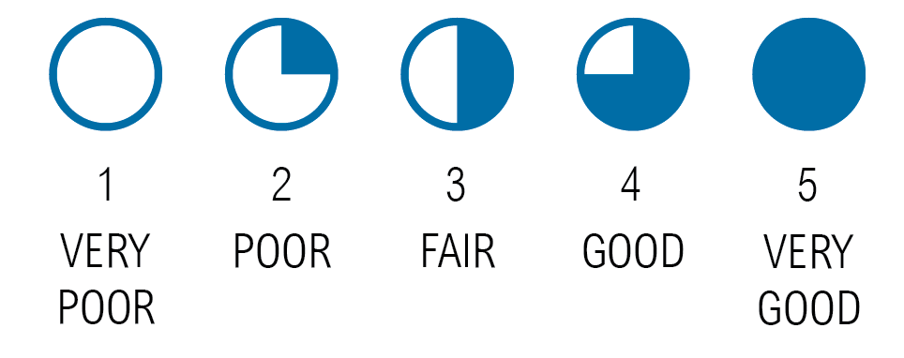
Key to Results at a Glance

Slide 14
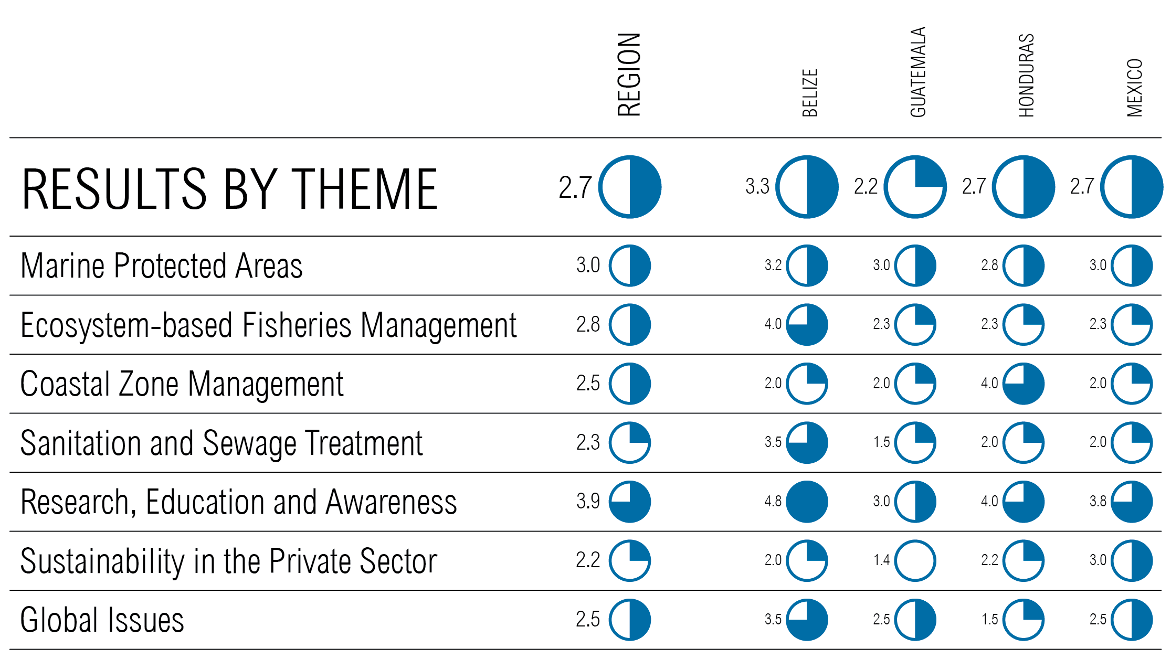
All docs on www.healthyreefs.org

Slide 15
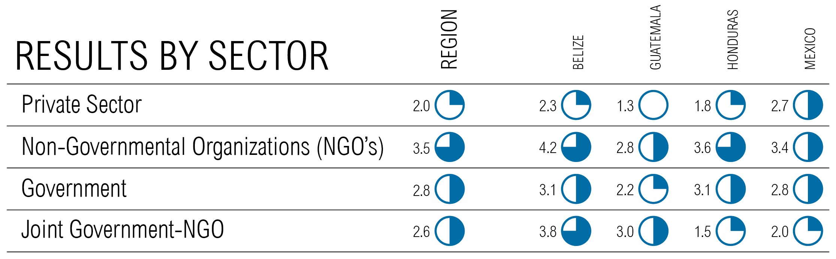
Indicators can also be evaluated by sector
All docs on www.healthyreefs.org

Slide 16
The 2011 Eco-Audit Team
Project Team
Melanie McField, Healthy Reefs Initiative
Benjamin Kushner and Lauretta Burke, World Resources Institute
Country Leads
Marisol Rueda Flores, Healthy Reefs Initiative Mexico
Ian Drysdale, Healthy Reefs Initiative Honduras
Ana Giro, Healthy Reefs Initiative Guatemala
Roberto Pott, Healthy Reefs Initiative Belize
GIS Database
Lorenzo Álvarez Filip, Healthy Reefs Initiative
PricewaterhouseCoopers Costa Rica (PwC) Technical Reviewers
Antonio Grijalba
Monica Azofeifa
Claudia Amaya
Ximena Lacayo

Slide 17
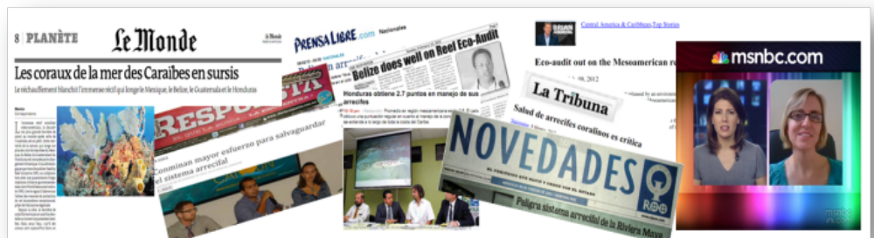
Work with the media to put reef management issues on the front burner of popular politics
coastal development
protected areas
protected areas
We need to raise the bar and pick up the pace of management efforts
Notes:
Getting results is work… but translating thenm into real Accountability…and probabliy regulatory changes….its critical to build popular support Media attention makes it a popular issue which makes it a political issue. Without that pressure the pace and

